Slide 1
FAS 8040 cDOT Shared Architecture
Storage Design and Engineering An Introduction to Shared cDOT Architecture at TR
David Ellis
12/3/14

Slide 2
Agenda
INTRODUCTION
8040 Primary
8040 Secondary
Licensing
Performance and Capacity
QOS
Configuration
Naming Conventions
Data Protection

Slide 3
Clustered Data Ontap 8.2 (cDOT)
Scalable software platform from NetApp which allows for Non Disruptive operations and QOS mgmt.
Limitations
1000 Volumes per controller
125 Vservers per controller (VSM’s)
63 Cluster Peers
8 Nodes per cluster – Limitation as a cost of utilizing ISCSI
Currently no availability to manage CIFS shares using MMC, feature enhancement v8.3, currently utilizing Netapp Powershell Plugin
No support for showmount, current script workaround in place /tools/infra/bin/netapp_showmount –e enhancements to come in the future.

Slide 4
8040 Primary Design
Primary Storage Cluster Design
Mix of HT and LT HA pairs in a cluster
Switched Cluster
Managed by two cluster switches, CN1610, Netapp will provide support for these switches, not TR Networking team.
FAS8040 HA Pair - Hybrid SSD/SAS Drives – High Tier
DS2246 shelves 600 GB 10k SAS Drives
Min Configuration 6 / Max Configuration 12
DS2246 shelves of 400GB SSD
2 shelves of 9 Dives 2000GB of cache/controller
FAS8040 HA Pair – SATA Drives – Low Tier
DS4246 shelves 2TB 7.2 Sata Drives
Min configuration 4/ Max Configuration 6
512 Gb of Flash Cache per controller

Slide 5
8040 Seconday/Backup Design
Seconday/Backup Standalone Cluster
FAS8040 Single Node cDOT system
Can be converted if deemed necessary to add nodes to the backup cluster
DS4486 Shelves of 4TB 7.2K SATA DRIVES
1 Shelf min configuration/4 Shelves Max

Slide 6
Licensing
Primary 8040HT/8040LT
NFS
CIFS
ISCSI
Snapvault
Snapmirror
Snap Restore
BKP 8040
NFS
CIFS
Snapvault
Flexclone
Snapmirror
Snap Restore

Slide 7
Performance and Capacity
High Tier 8040
LT 8040
27TB / 56TB Base/Max config
Peak Throughput @ 32k 50/50 mix
1148MB/Sec
36,750 IOPS /Controller
Peak Throughput @ 4k 50/50 Mix
172 MB/Sec
44250 IOPS /Controller
52 TB/ 78TB Base/Max Config
Peak Throughput @ 32K 50/50
20700 IOPS/Controller
646 MB/sec
Peak Throughput @4K 50/50
20700 IOPS/Controller
80MB/sec

Slide 8
cDOT and QOS
With the introduction of cDOT also comes the integration of QOS.
QOS is maintained through policies created on the cluster and assigned to a particular volume, SVM , or collection of storage objects.
QOS limitations can be set as IOPS or MB/s but not both.
TR implementation will apply a singular QOS policy per volume limited to 6000 IOPS.
QOS policies are applied at the volume level to allow TR to take advantage of wlstats and OPM metrics.
Volumes where there are no limitations being imposed, should contain a qos policy, their restriction can be marked with, INF. e.g-archlog volumes on the 3050’s

Slide 9
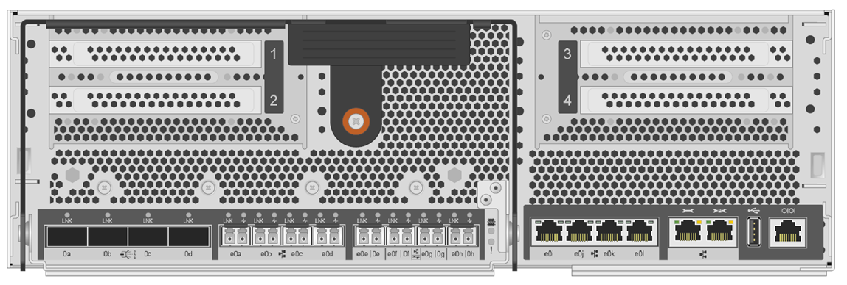

Controller Configuration Details
Flash Cache (LT Deployments)
SAS Adapter
SAS Ports
10GbE Ports (Data)
1GbE Ports (Mgmt)
Service Port (SP)

Slide 10
Network Connectivity
Type | Ports
Cluster Port 10 Gbe | E0A,E0C
SP 1 Gbe | SP
Data 10Gbe | E0B,E0D
Mgmt 1 Gbe | E0i
Cluster Ports should not be confused with intercluster ports. Cluster ports are used for intracluster traffic where as Intercluster ports, which maybe data ports, are used for communications between clusters, i.e snap mirror operations.

Slide 11
Logical Interfaces – LIF’s
Possible LIFS on a cluster
Node-Mgmt LIF- provides dedicated IP address for managing a particular node, gets created at the time of creating or joining a cluster.
Cluster-Mgmt LIF- provides access to the cluster with management capabilities, can only exist on one node at a time but capable of being failed over between nodes.
Data LIF- Associated with a vsever and is used for communicating with clients. Data LIFs can only exist on data ports.
Intercluster LIF- Utilized for cross-cluster communication, handling backup and replication. Can be configured on either data or intercluster ports.

Slide 12
Aggregate Considerations
 | 8040 HT | 8040 LT | 8040 BKP
Max Aggr | 324 TB | 324 TB | 324TB
Max Vol | 100 TB | 100 TB | 100TB
Raid Group Size | 8 SSD Drives in own RAID-DP RG of flashpool aggregrate. 19 SAS Drives per RG in Flashpool Aggregrate | 14 SATA drives per raid group in the data aggregrate. | 16 Sata Drives Per Raid Group in the data aggr *2 Data Aggrs/Node
Initial Config | 1 Root Aggr 3 SAS drives per controller. 1 data aggr of 1 ssd raid group and 3 sas raid group per controller. 23 TB usable/Controller | 1 Root Aggr with 3 SATA Drives 1 Data Aggr of 3 raid groups per controller 52 TB usable/controller | 1 Root Aggr with 3 Sata Drives 1 Data Aggr of 2 raid groups\ 91 TB usable
Final Config | 1 Root Aggr 3 SAS drives per controller. 1 data aggregrate of 1 SSD raid group and 7 SAS raid groups per controller. 56TB usable/Controller | 1 Root Aggr with 3 SATA Drives 1 Data Aggr of 4.5 Raid groups per controller 78TB Usable\Controller | 1 Root Aggr with 3 Sata Drives 1 Data Aggr of 5.5 Raid groups 1 Data Aggr of 6 Raid Groups 532TB Useable\Controller

Slide 13
cDOT naming conventions
Cluster
<DataCenter= 2 characters><CIS or CPS= 3 charaters><BK=Backup, DD=Dedicated, SH=Shared AA=Archive><2 digits for number><1 character = site>
EG-CPS-CLSH-E01
Node
<cluster-name>-NXX
EG-CPS-CLSH-E01-N01
VSM
<GRP><TECH>-<SiteID>XXXX
CPSPROD-F0129
LIF
Data LIF
<VSM>-LIF
CPSPROD-F0129-lif
Intercluster LIF
<Node>_icl_lif
EG-CPS-CLSH-E01-N01_icl_lif

Slide 14
cDOT Naming Conventions
Aggregate Naming Standard
<aggr_string=’aggr’><aggr#>_<aggr_type >_<disk_type><disk_size>_<Node=’n’><Node_Number>
Aggr_string = Characters which show this is an aggregate: ‘aggr’.
Aggr# = aggregate number starting with 0 (no padding). This number is incremented by 1 for each aggregate which is added to a node.
Aggr_Type = String (‘root’ or ‘data’) designation which defines this as a root or data aggregate.
Disk_Type = String designation (‘sas’ or ‘sata’) which shows the type of disks in the aggregate
Disk_Size = Size of disks in the aggregate, e.g., ‘1200’.
Node = ‘n’
Node_Number = Number of the node in the cluster. The first node will start with ‘01’. This number will be incremented by 1 for each node which is added to the cluster.
aggr1_data_sas600_flash_n02
Volume
<CB number-customerid>_<apps>_<snap r nosnap>
CB Number = 4 Digit Customer ID
Apps = Application or product code
Snapvault Vol Naming
sv_<ret>_<CB number>_<apps>

Slide 15
Data Protection
Done using an extended command directory of Snapmirror, essentially functions as snapvault.
Requirements for successful XDP relationship
Cluster peer
Vserver peer
Snapmirrror Schedule – Managed on the bkp filer through cron jobs
Snapmirror schedules will follow a 24 hour scheduled denoted by XDP-xx, where xx represents the hour the latest snapshot will be vaulted, 00 01 02..etc
Snapmirror Policy – Local policy to the bkp volume

Slide 16
Additional Resources
TR Specific Docs
Storage Wiki
General cDOT Information
Netapp Now Site
Netapp SharePoint Site
Colleagues
David.ellis@thomsonretuers.com

